Slide 1
Clive Burdon
Senior Producer
cburdon@vvisions.com

Slide 2
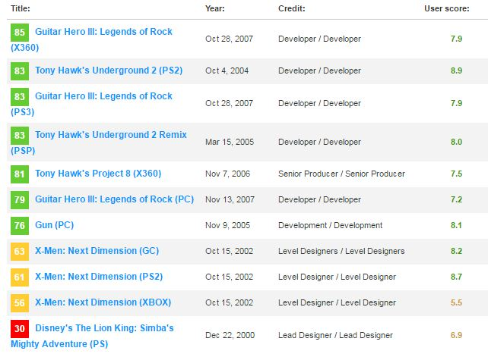
Who’s this guy with weird accent?
Sr. Producer at Vicarious Visions
22 year industry vet
28 titles ??? It maybe more. ☺
Argonaut Software
Paradox Development
Left Field Productions
Neversoft Entertainment
343 Industries
Vicarious Visions
Gamertag/PSN: WyzeOne
Notes:
Argonaut Software – Star Fox, Creature Shock, Harry Potter
Paradox Development – Thrill Kill, X-men, Mortal Kombat
Left Field Productions – MTX Mototrax
Neversoft Entertainment – Tony Hawk, Guitar Hero
343 Industries – Halo 4, 5

Slide 3
Vicarious Visions
In 2016, Vicarious Visions celebrated its 25th year making video games. Over the years, we have made hundreds of games, in every genre, on every conceivable game platform in the known universe. If there is a device with two buttons and a screen, VV has released for it. We are a studio that is built to last.
Our philosophy of combining cutting-edge tech with creative innovation is evidenced in all of our products – from Skylanders to Marvel Ultimate Alliance to Tony Hawk to Guitar Hero; we apply the same dedication to excellence to every major video game franchise we’ve worked on over the years.
We thrive on a culture of collaboration, respect and fun. We have built a welcoming and relaxed workplace that invites creativity and encourages individual voices. We not only give our developers a safe, warm place to incubate and grow their ideas but the tools and support necessary to turn those ideas into impactful and memorable experiences.

Slide 4
Vicarious Visions
Our studio is located in Albany, NY, a thriving Northeast city with an abundance of professional theatre, music, dance, sports, and a backyard full of recreational activities. (That’s a metaphorical backyard. The studio’s backyard has a patio and grill though…with seasonal awning.) And for those looking for more adventures, we’re located less than three hours from NYC, Boston, and Montreal!
VV manages a diverse portfolio of games, shipping multiple projects every year.

Slide 5
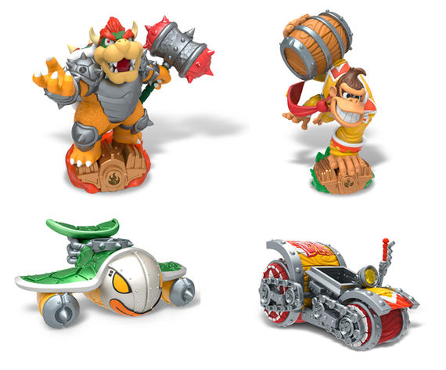
Our Most Recent Projects

Slide 6
Game Development Disciplines
Art/Animation
Design
Engineering/Programming
Audio
Production
QA

Slide 7
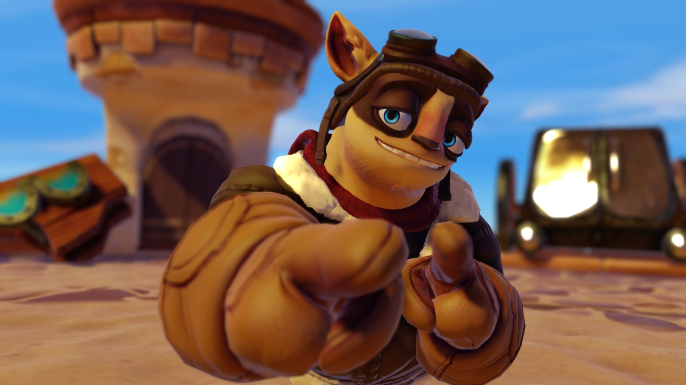
What Does It Take To Be A Producer?
A college degree in:
Art/Design
Engineering
Production
Background in team management
Problem solver
Knowledge holder
Great communicator
Solid planner
Background in hostage negotiation
Notes:
It can feel like you need a background in hostage negotiation

Slide 9
Problem Solver
Rudyard Kipling poem “IF”
“If you can keep your head when all about you are losing theirs…
…you may have misread the situation.”
There’s always a solution
Change
Scope
Fix
Provide options

Slide 10
Knowledge Holder
There is no piece of information you cannot find
Have it in your data
Find the person who does know
Somebody has done it before
Get enough information to answer more than the question asked
1st Party requirements
Notes:
Have it in your data: Know actuals not anecdotal evidence - Empowers your team

Slide 11
Great Communicator
Know your audience
Give the information that’s asked for
Be concise
Add detail if needed
You are the umbrella for your team
Advocate for your team
Never promise or agree to anything without the team knowing
All conversations are “Yes, and”
Never “No”
Be the facilitator not the contributor first
Notes:
Remove your ego from it

Slide 12
Solid Planner
Work from your ship date backwards
Project dependent
Team dependent
Whole project vs sprint
Two groups who have it worst
Audio
Localization
Notes:
Where is the game
Anecdote
You hold the knowledge and plan for the whole project – sprints are for the team

Slide 13
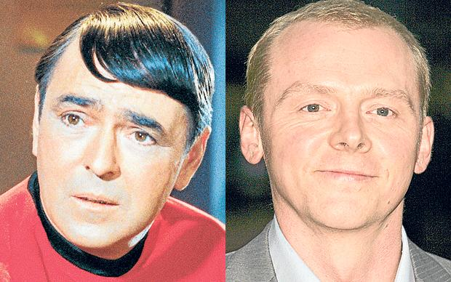
Solid Planner
Think like this guy

Slide 14
Solid Planner
Find a method that works
Agile
Scrum
Kanban
Lean
Waterfall
Scrumterfall
Choose how you track tasks
Jira
Shotgun
Excel
MS Project
TFS
TicketTrack
Email
Cards
Notes:
None of these methods or software options was made with game development in mind.

Slide 15
Project Cycle
Pre-production
Production
Alpha
Beta
Submission/Gold
Post Mortem
Day 1 patch
Live Support
DLC1
DLC2
Remaster in 5 years
Notes:
There are 11 that I’ve listed.

Slide 16
Day To Day?

Slide 18
What do I mean by invisible?
Production’s role:
Facilitate decisions
Facilitate discussions
Communicate the vision
Give feedback
Provide information
Production’s other roles:
Identify and fill in gaps
Fosters better processes
Communicate information to stakeholders
Collect data and more data

Slide 19
Sources Of Information
Gamasutra: What makes a good game producer?
Part 1
Part 2
So you want my job: Video Game Producer
Interview
Wikipedia’s definition
Video Game Producer

Slide 20
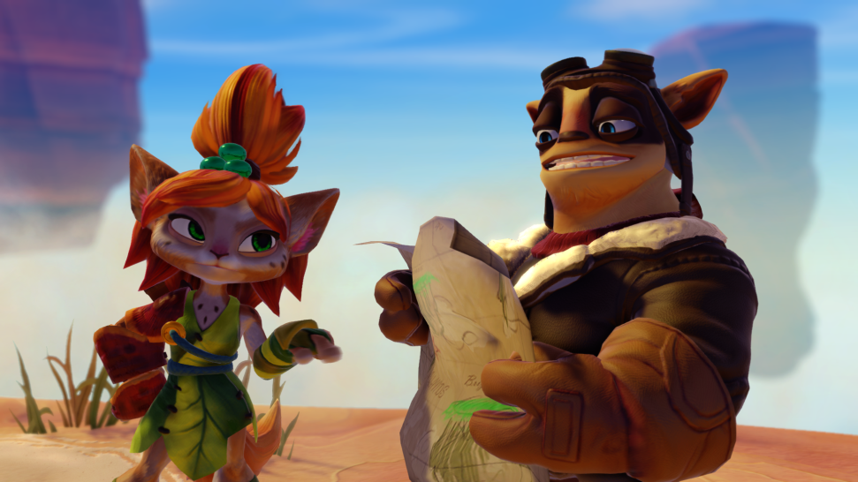
Questions?
Clive Burdon
Sr. Producer
cburdon@vvisions.com

